Slide 1
Lab 3: Data Visualization
Ying shen and hao deng
School of software engineering
tongji university

Slide 2
Tasks in data visualization
Task Categories | Task Types
Data and view specification | Visualize data by choosing visual encodings Filter out data to focus on relevant items Sort items to expose patterns Derive values of models from source data
View manipulation | Select items to highlight, filter, or manipulate Navigate to examine high-level patterns and low level detail Coordinate views for linked exploration Organize multiple windows and workspaces
Process and provenance | Record analysis histories for revisitation, review, and sharing Annotate patterns to document findings Share views and annotations to enable collaboration Guide users through analysis tasks or stories

Slide 3
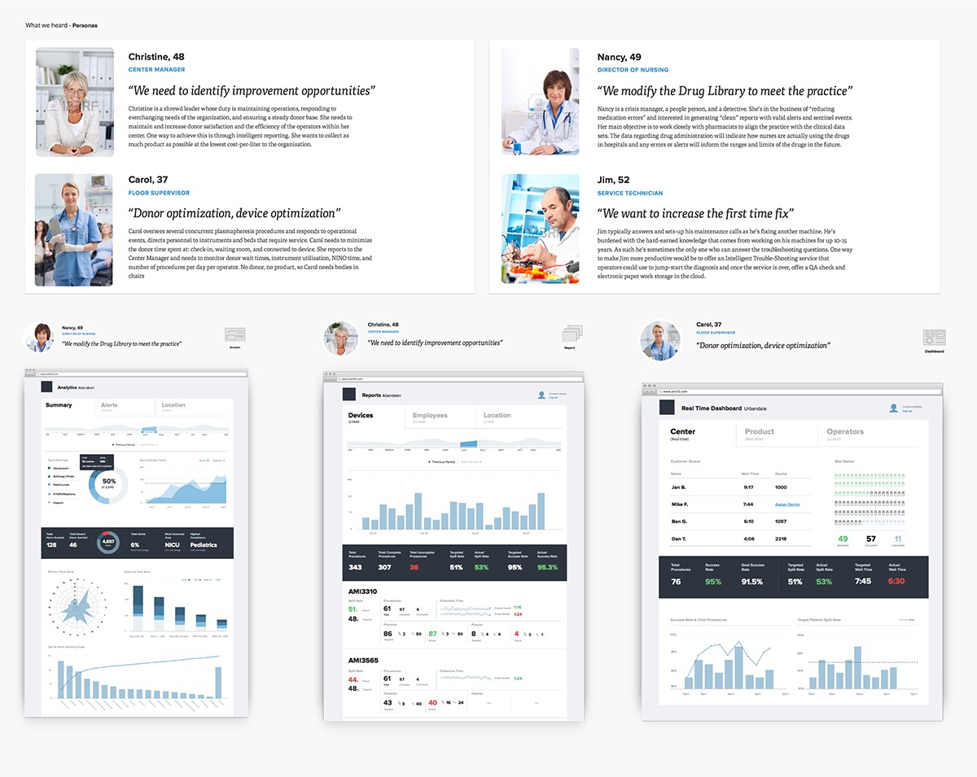
Designing data-driven interfaces
Different users, different data
Notes:
https://blog.truthlabs.com/designing-data-driven-interfaces-a75d62997631
http://www.woshipm.com/data-analysis/691262.html

Slide 4
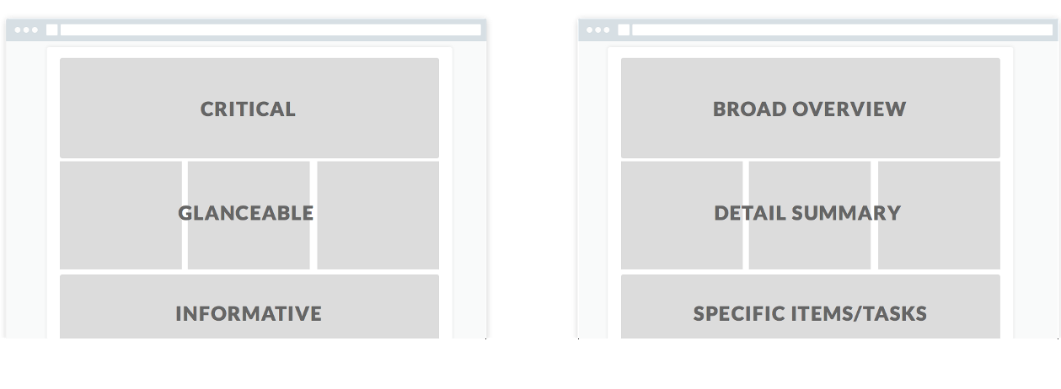
Designing data-driven interfaces
Shape the Page
Show the user what they need to see first, then structure the remainder of the page based on the user story or hierarchy of information.

Slide 5
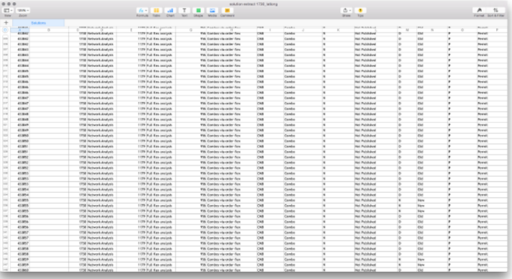
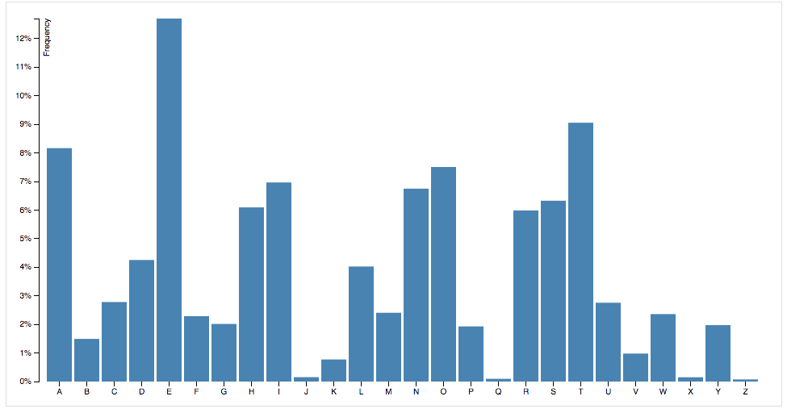
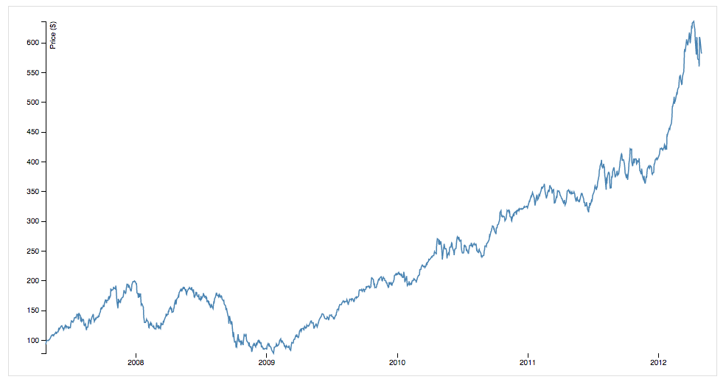
Designing data-driven interfaces
Choose the “right” visualizations
Start with the Data
Working with Discrete vs. Continuous Data

Slide 6
Designing data-driven interfaces
Dashboard
Notes:
https://blog.truthlabs.com/designing-data-driven-interfaces-a75d62997631
http://www.woshipm.com/data-analysis/691262.html

Slide 7
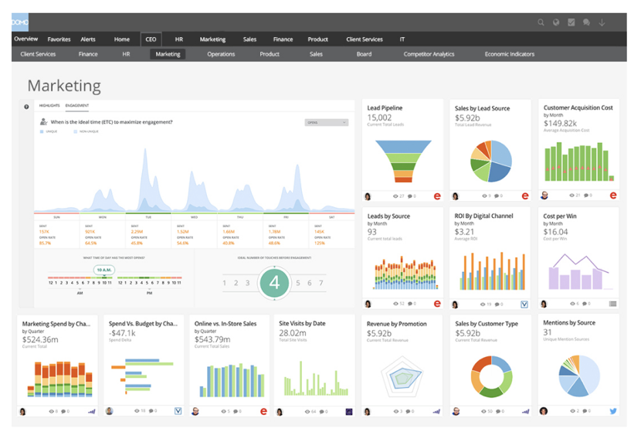
Designing data-driven interfaces
Segmentation of users
Notes:
https://blog.truthlabs.com/designing-data-driven-interfaces-a75d62997631
http://www.woshipm.com/data-analysis/691262.html

Slide 8
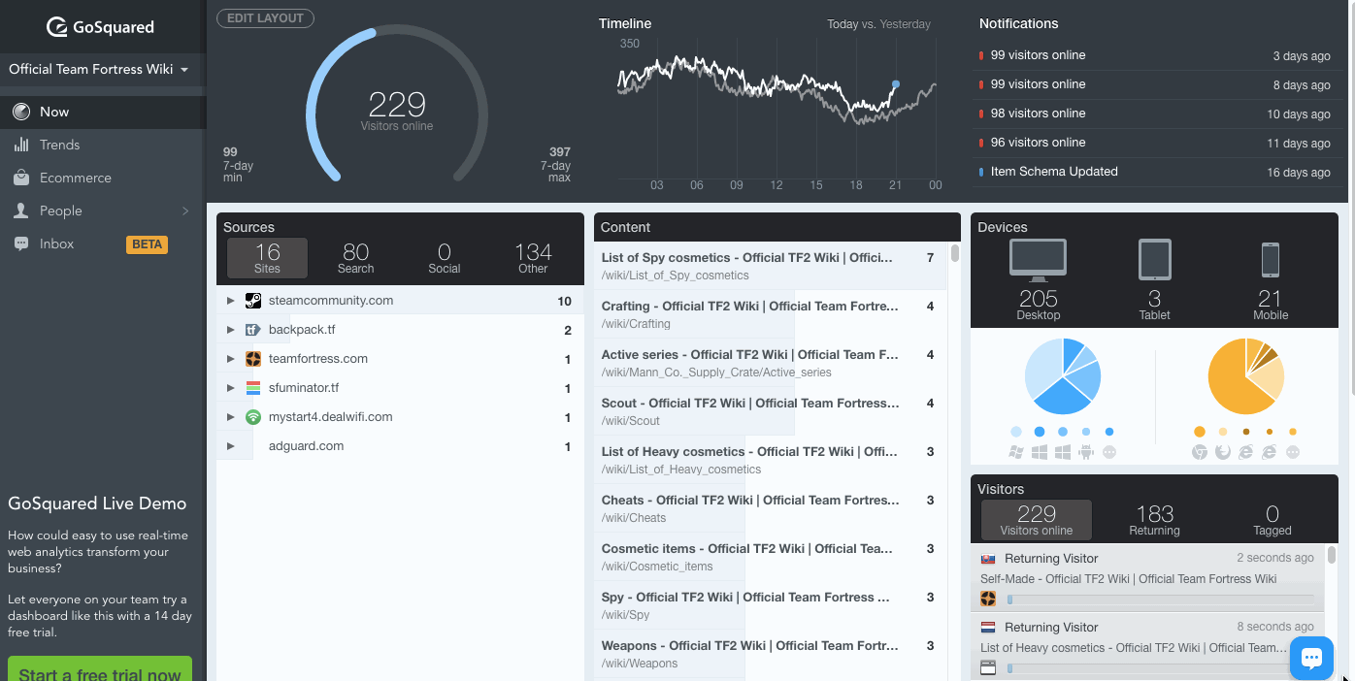
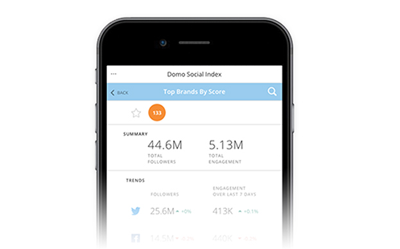

Designing data-driven interfaces
Dividing the scene
Notes:
https://blog.truthlabs.com/designing-data-driven-interfaces-a75d62997631
http://www.woshipm.com/data-analysis/691262.html

Slide 9
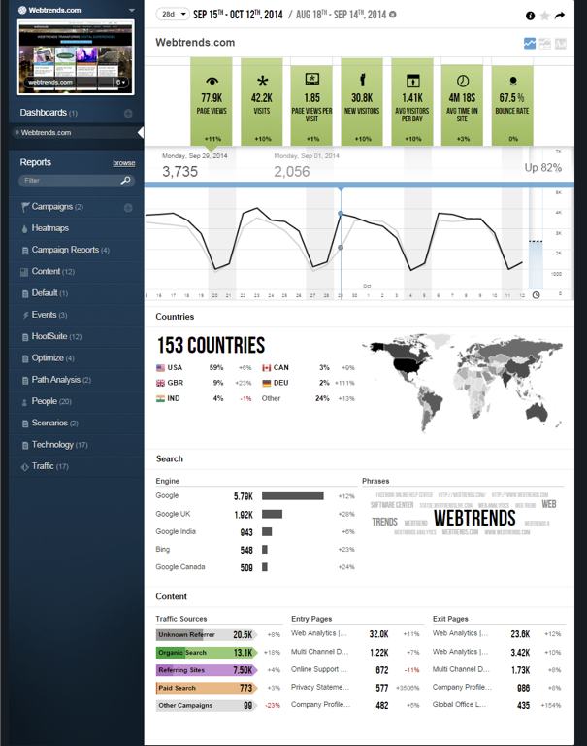
Designing data-driven interfaces
Less is better than more
Notes:
https://blog.truthlabs.com/designing-data-driven-interfaces-a75d62997631
http://www.woshipm.com/data-analysis/691262.html

Slide 10
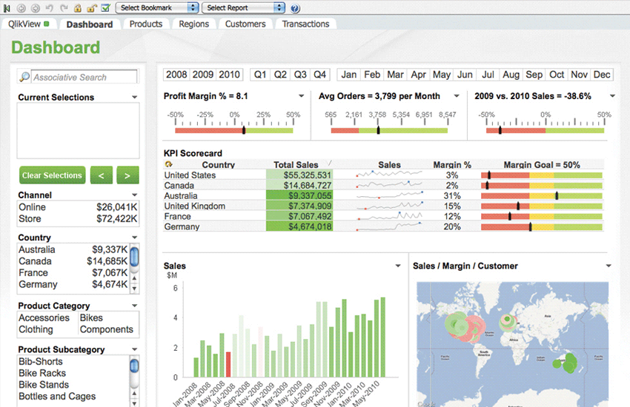
Designing data-driven interfaces
Comparison
Notes:
https://blog.truthlabs.com/designing-data-driven-interfaces-a75d62997631
http://www.woshipm.com/data-analysis/691262.html

Slide 11
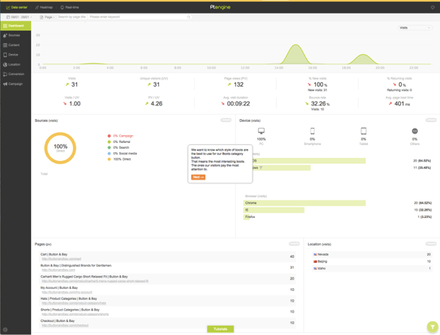
Designing data-driven interfaces
Segmentation
Notes:
https://blog.truthlabs.com/designing-data-driven-interfaces-a75d62997631
http://www.woshipm.com/data-analysis/691262.html

Slide 12
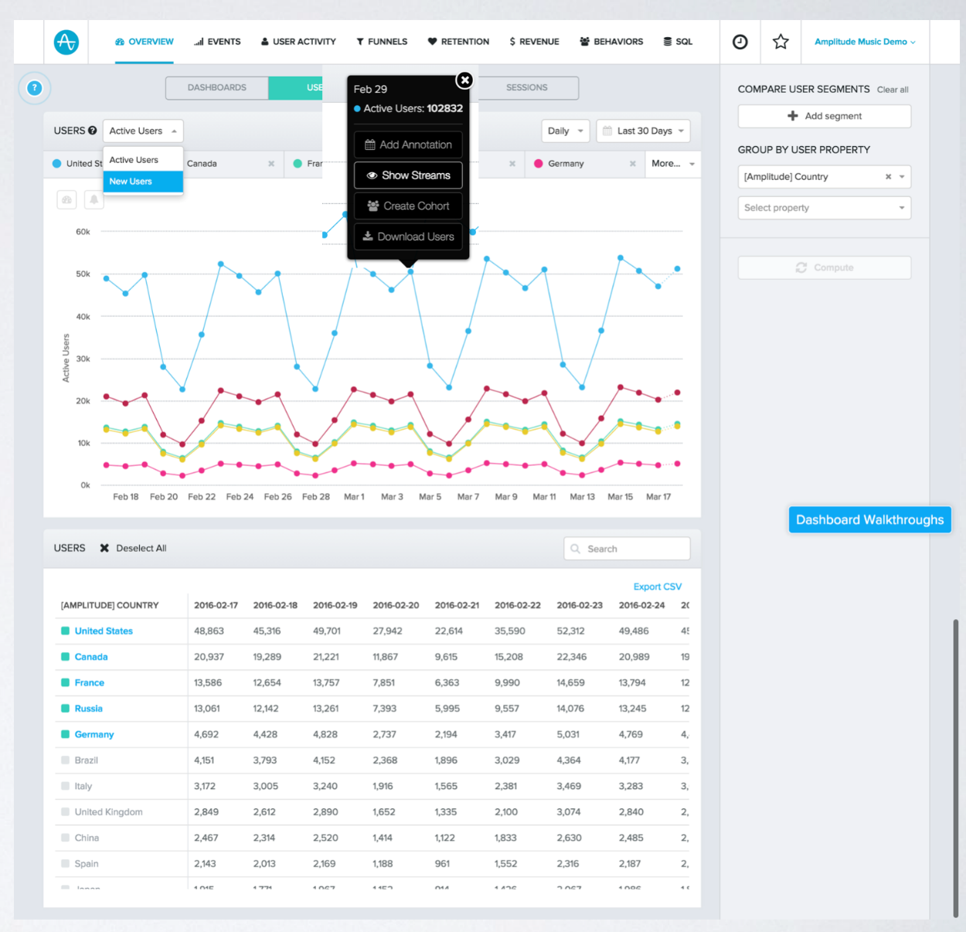
Designing data-driven interfaces
Traceability
Notes:
https://blog.truthlabs.com/designing-data-driven-interfaces-a75d62997631
http://www.woshipm.com/data-analysis/691262.html

Slide 13
Designing data-driven interfaces
Dashboard Design Principles
在功能设计上
突出核心指标：不能让复杂的设计掩盖了指标的呈现
突出对比：时间对比，空间对比，设计对比等等
提供细分及下钻：方便用户在有疑问时能够快速得到方向
减少用户选择：提供默认的同环比和时间选择，提供最常见的维度切分
在可视化设计上
简洁为上：减少Tab、按钮、单选框、复选框，在1-2个页面里完成展示
避免过多的颜色和点缀：太多的颜色会让人眼花缭乱，失去重点
选择正确的可视化形式，可参见华尔街是怎么做可视化的
Notes:
https://blog.truthlabs.com/designing-data-driven-interfaces-a75d62997631
http://www.woshipm.com/data-analysis/691262.html

Slide 14
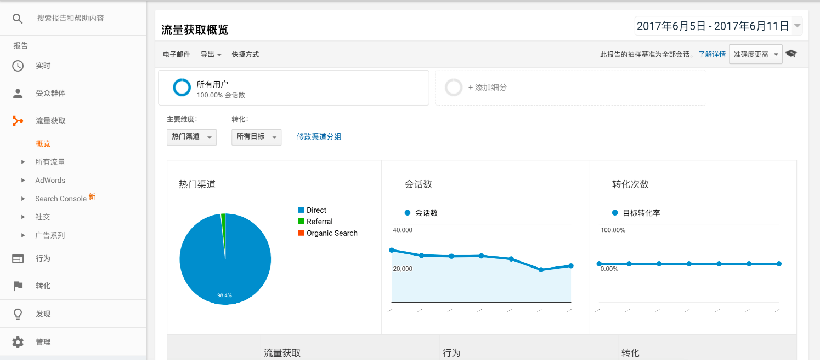
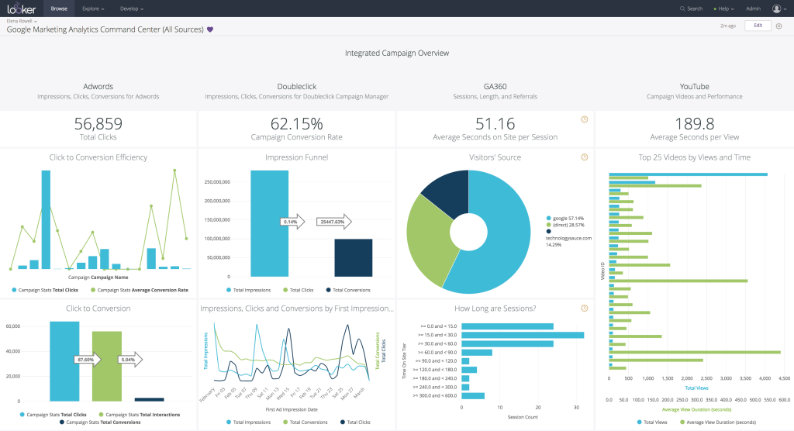
Dashboard examples
Notes:
http://c.raqsoft.com.cn/article/1535420833071?r=gxy

Slide 15
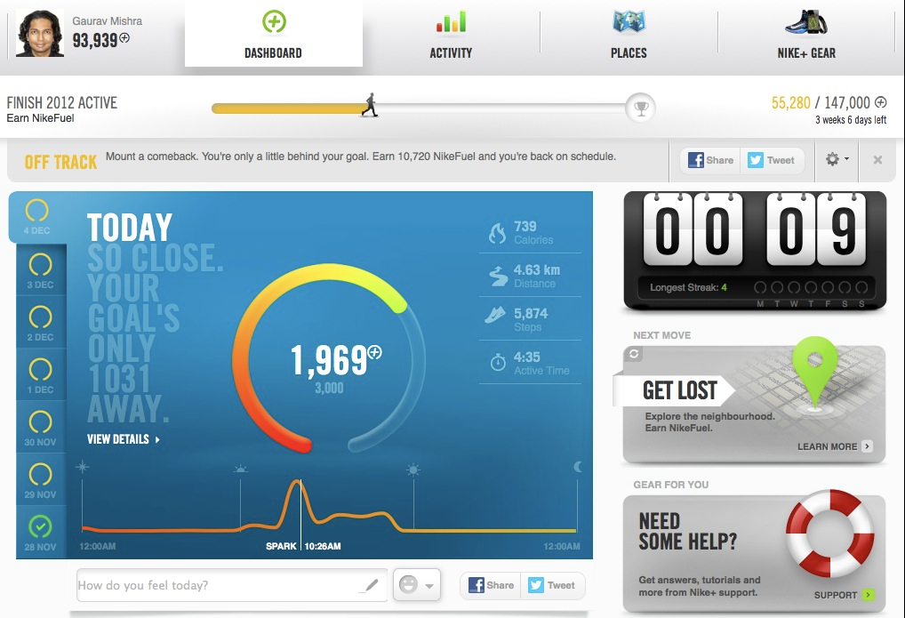
Dashboard examples

Slide 16
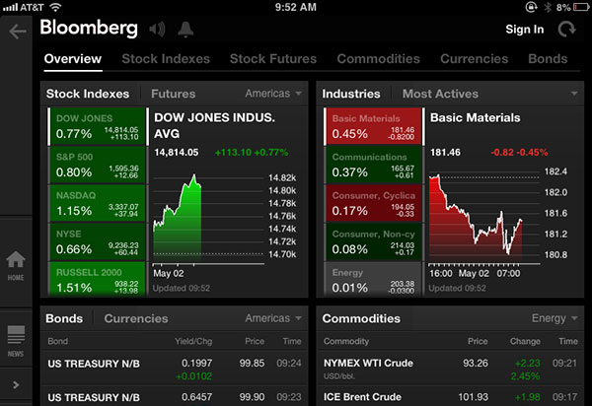
Dashboard examples

Slide 17
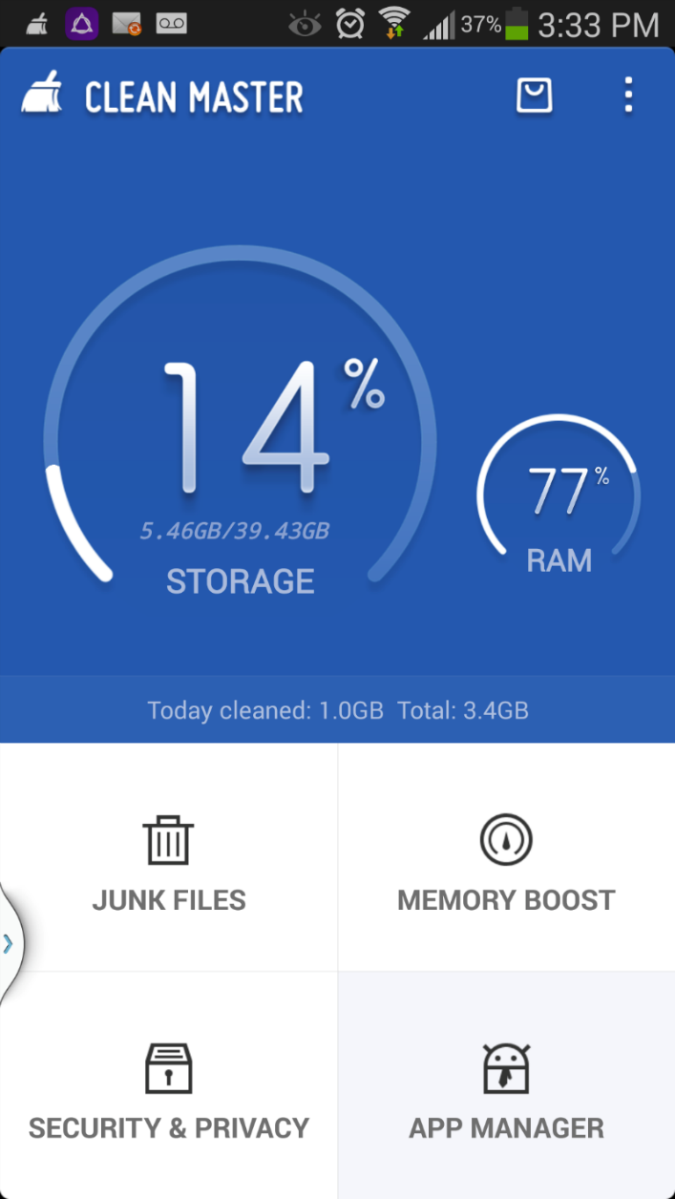
Dashboard examples

Slide 18
Dash in Python
Tutorial: https://dash.plot.ly/
Examples and source codes: https://dash.plot.ly/gallery

Slide 19
Dataset 1: Black Friday
Description
The dataset here is a sample of the transactions made in a retail store. The store wants to know better the customer purchase behavior against different products. Specifically, here the problem is a regression problem where we are trying to predict the dependent variable (the amount of purchase) with the help of the information contained in the other variables.
Classification problem can also be settled in this dataset since several variables are categorical, and some other approaches could be "Predicting the age of the consumer" or even "Predict the category of goods bought". This dataset is also particularly convenient for clustering and maybe find different clusters of consumers within it.
Notes:
https://www.kaggle.com/mehdidag/black-friday

Slide 20
Dataset 2: Google Play Store Apps
Content
Each app (row) has values for category, rating, size, and more.
Inspiration
The Play Store apps data has enormous potential to drive app-making businesses to success. Actionable insights can be drawn for developers to work on and capture the Android market!
Notes:
https://www.kaggle.com/lava18/google-play-store-apps

Slide 21
Dataset 3: College Salaries
Salary Increase By Type of College
Salaries By Region
Salary Increase By Major
All data was obtained from the Wall Street Journal based on data from Payscale, Inc
Notes:
https://www.kaggle.com/wsj/college-salaries

Slide 22
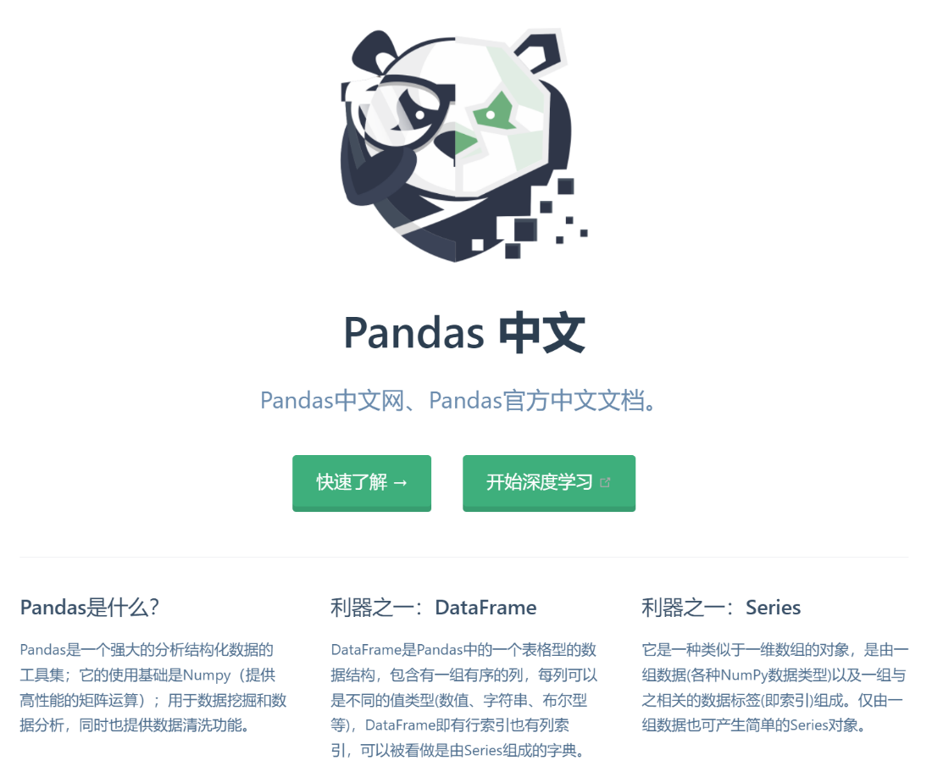
Install packages
pandas
dash
plotly

Slide 23
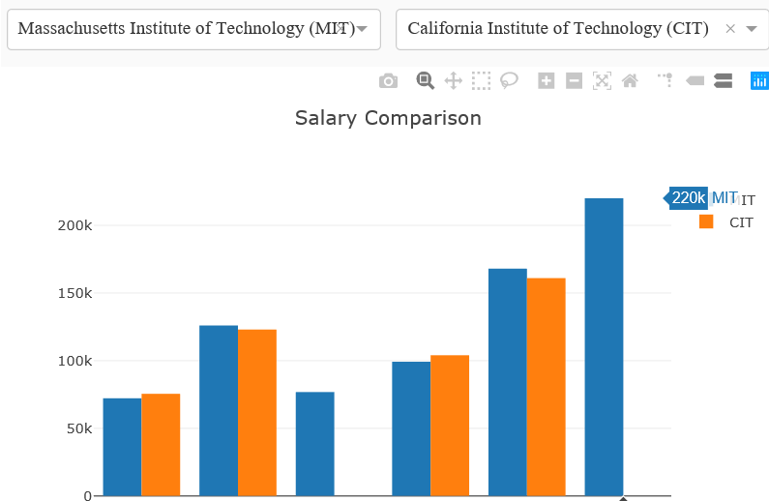
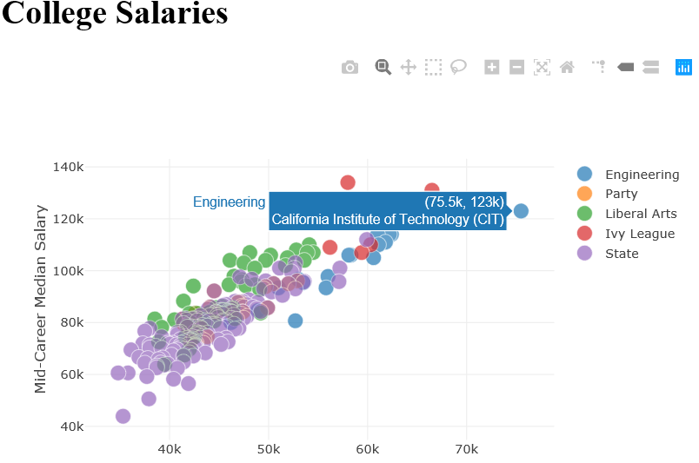
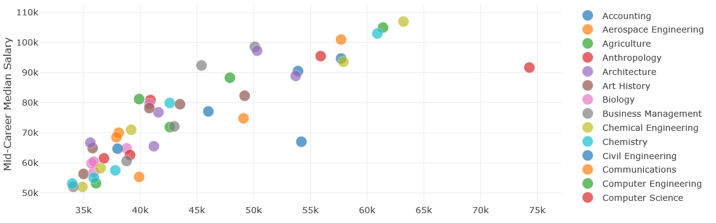
Assignment
Design and implement a Dashboard for one of three datasets
The dashboard should contain at least three graphs (e.g. scatter plot, bar chart, pie chart, line chart, etc) which reveal certain information respectively
It’s not necessary to visualize all the columns/rows of the dataset. You can choose only several of them.
An example

Slide 24
Report
The report should contains the following contents (in English, 2~3 pages):
Describe a data analysis task for the chosen dataset (objectives, characteristics of the dataset, etc);
Describe the layout of designed dashboard and briefly describe the patterns revealed in the figures.
Submit your work (code and report)
Prepare a readme file to illustrate how to run your program
Compress the codes and the report into a zip file: ID_name_lab3.zip
Canvas
6月17日前（最后一节课），迟交1天扣1分；截止补交时间6月22日

